Slide 1
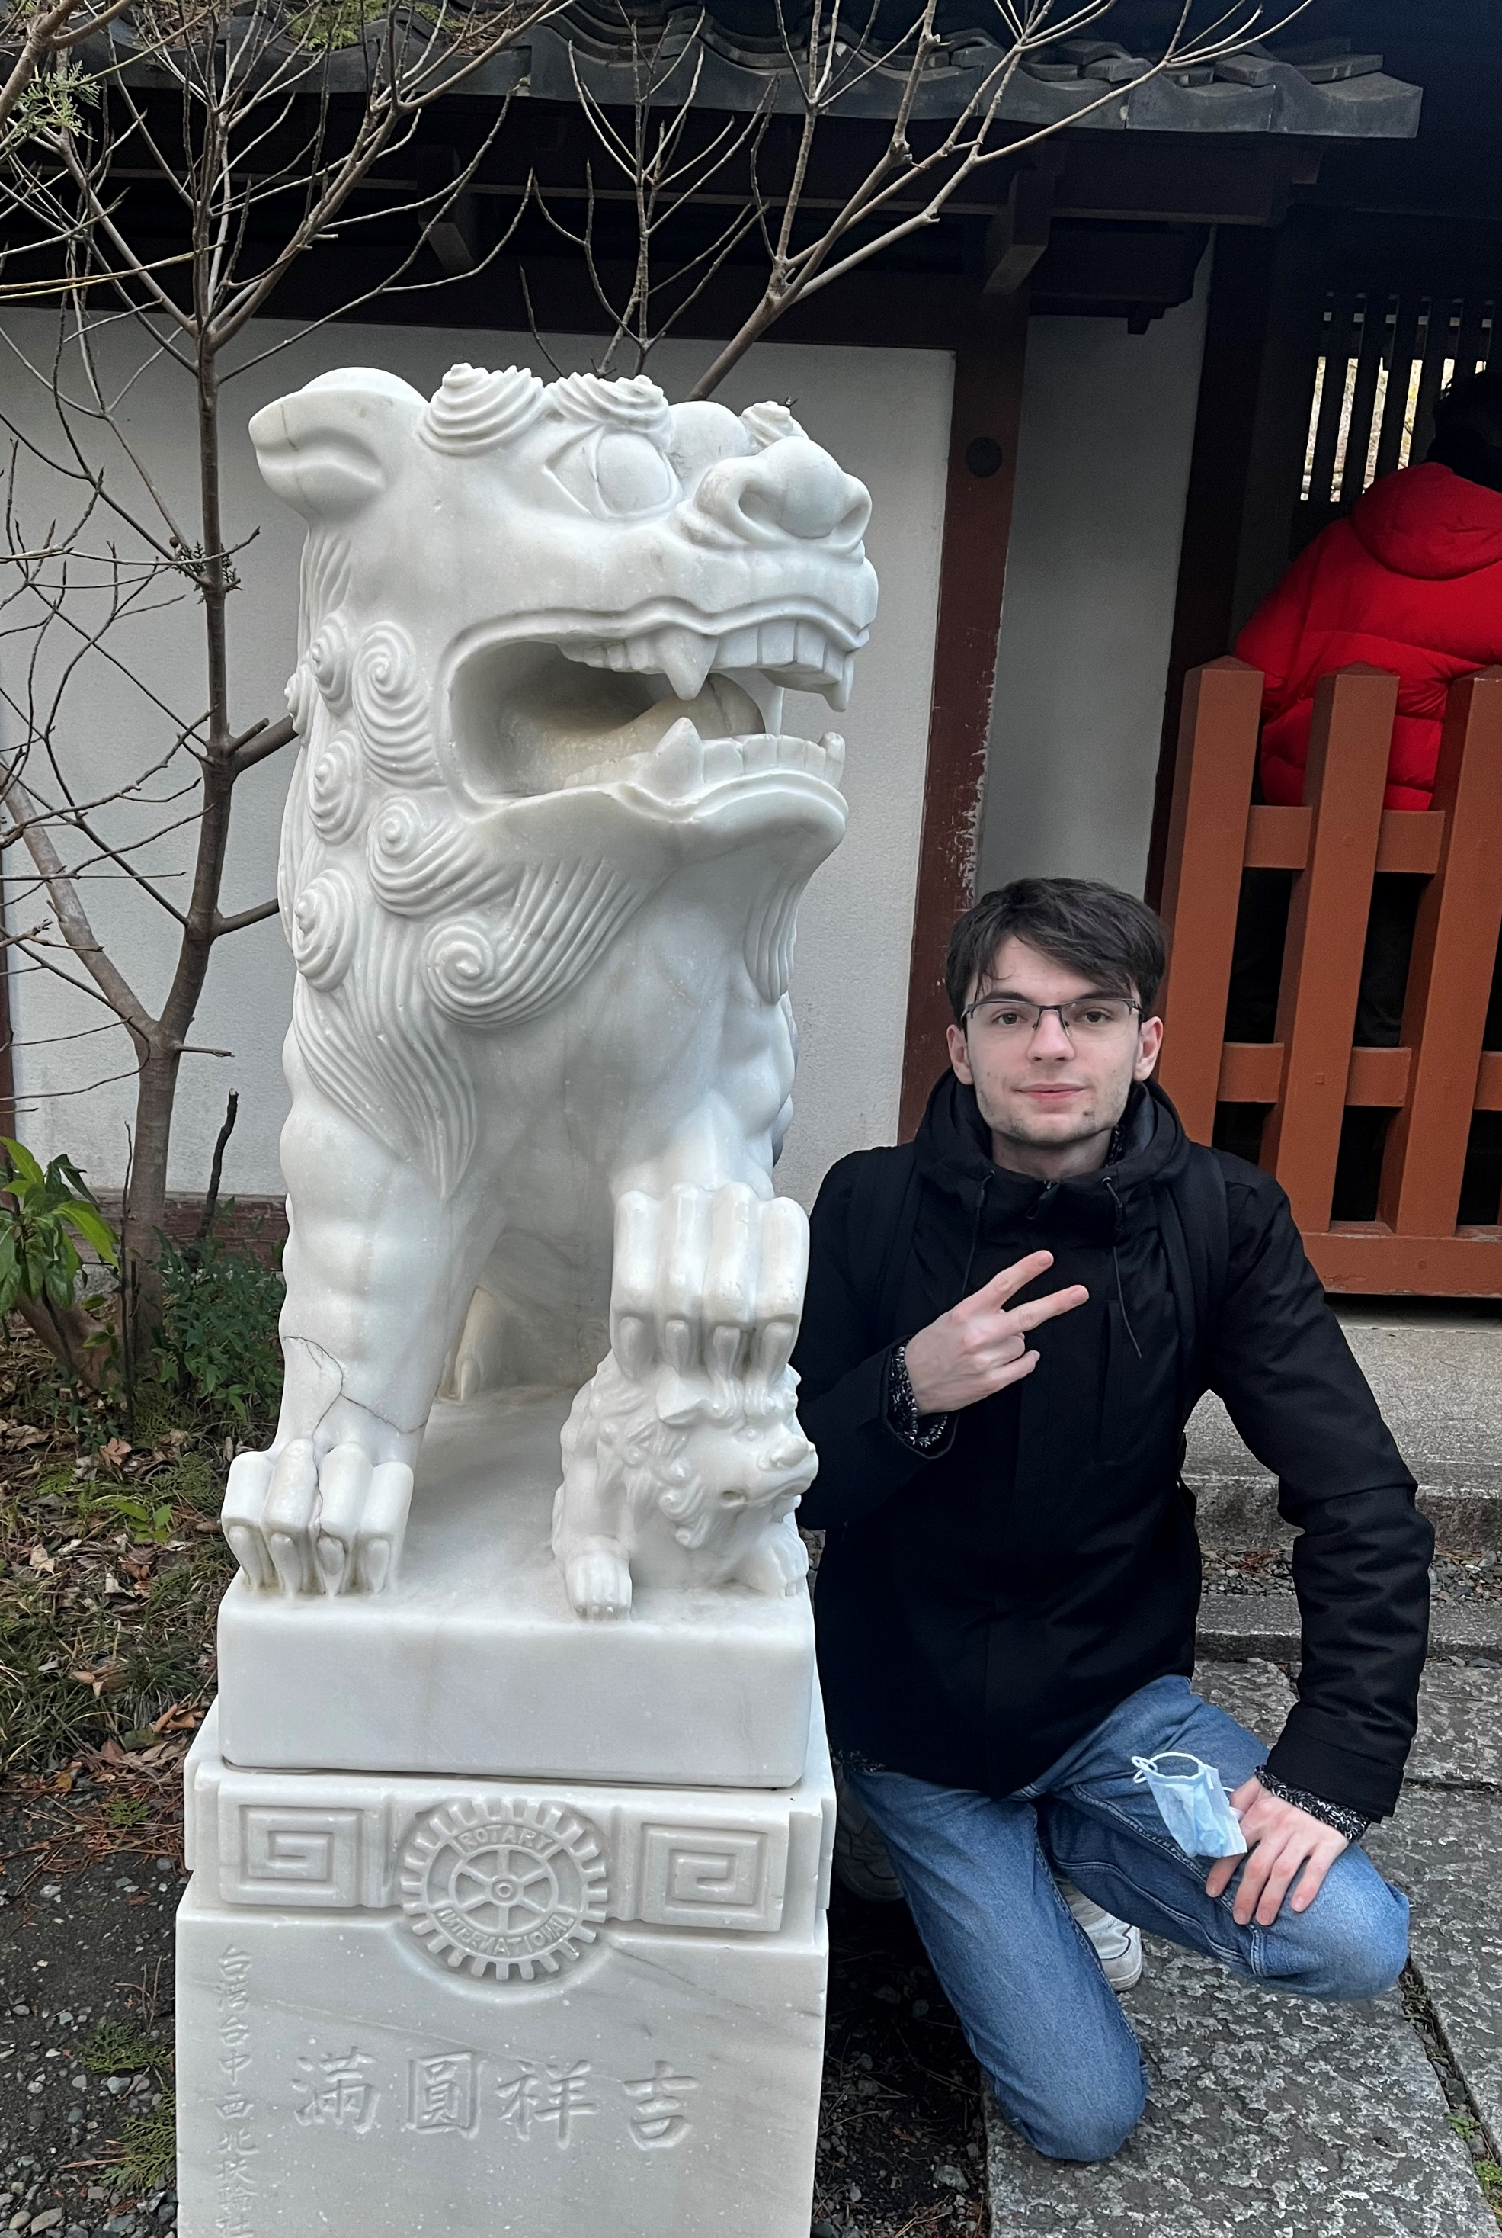
Academic Background
& Research Projects
Apprentice Research Engineer @ CEA
Physics & Microelectronic Systems @ CPE Lyon
Vincent Cauquil

Slide 2




Academic Background
Preparatory Classes
Apprentice Research Engineer @CEA
& Engineering Diploma @CPE
CPGE MPSI PSI
Physics & Microelectronic Systems
Intensive Maths & Physics training. Analytical rigor
Electronics & IC Design, Digital & Computing, Physics & Signal, Research Initiation
Research Intern
Cryogenic electronic and design of a high-density interconnects PCB
2023
2023
June
2025
Sept 2025
Sept 2026

Slide 3

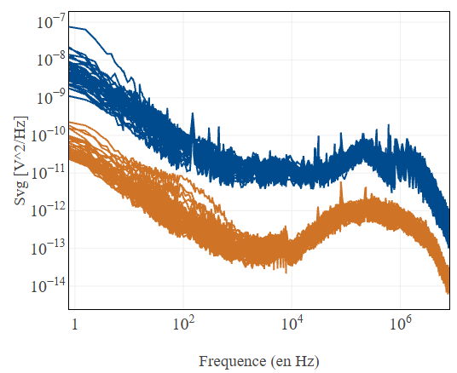
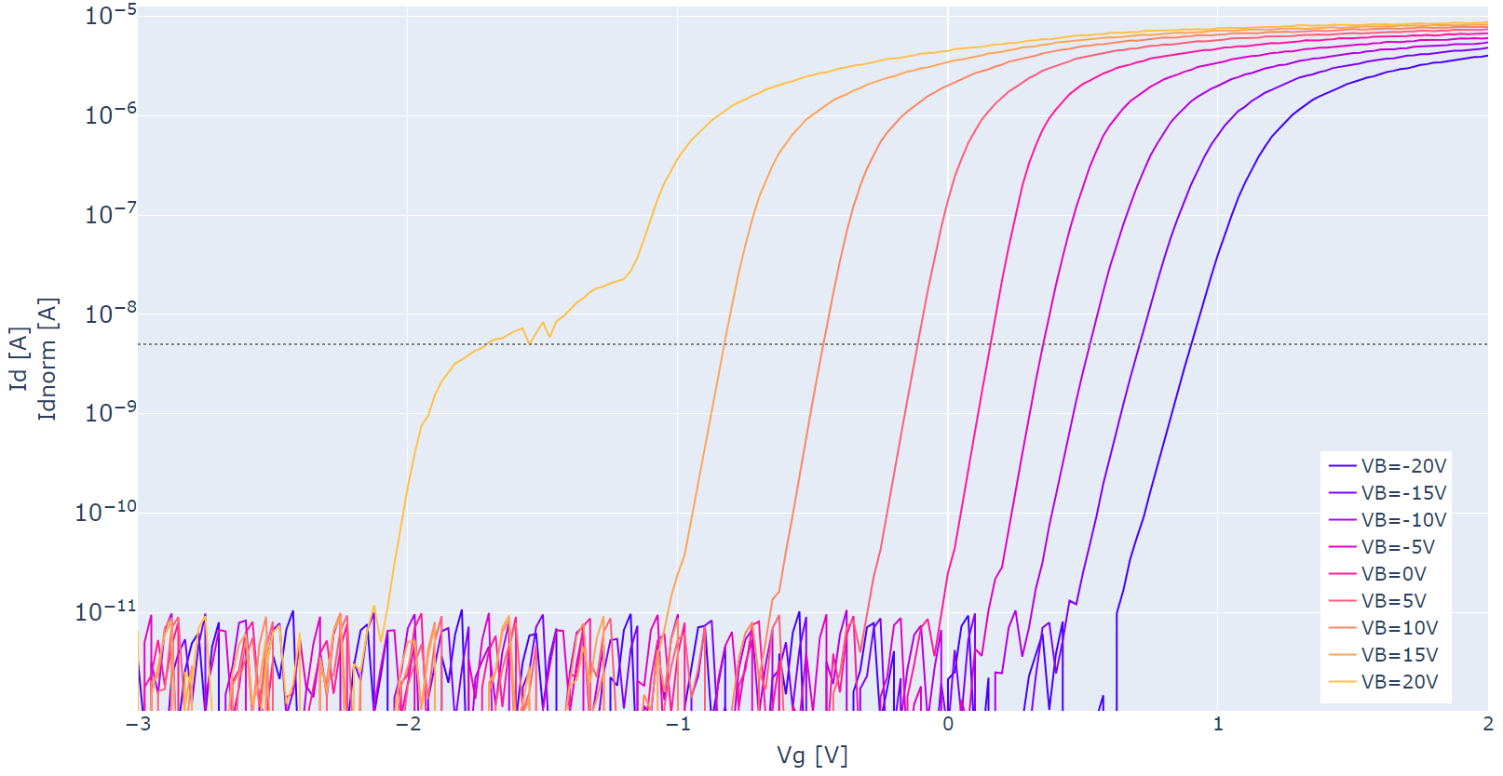
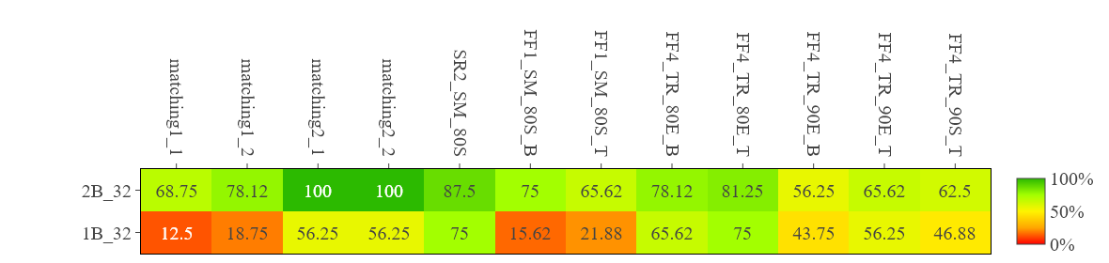
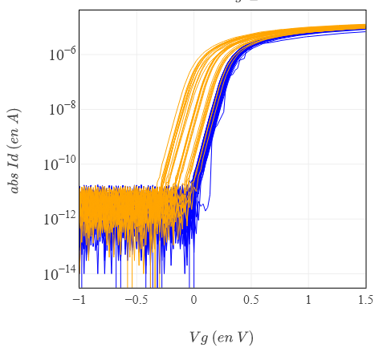
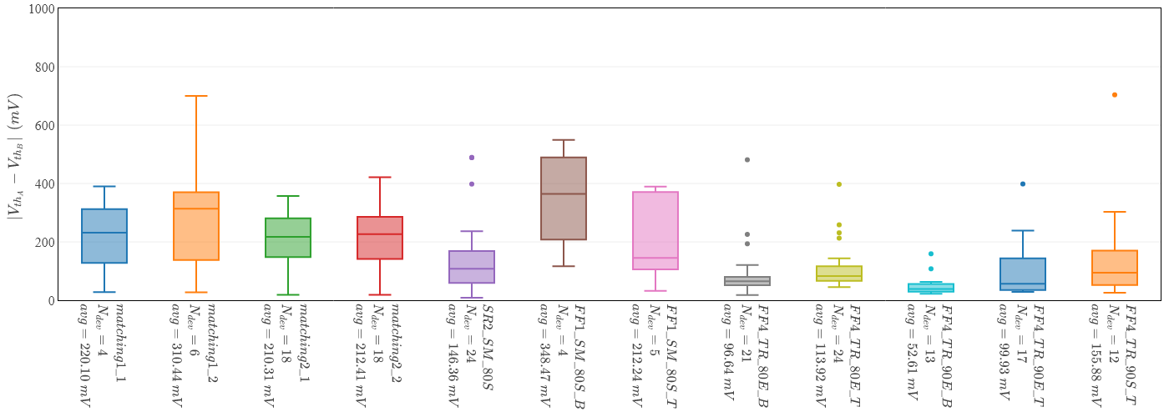
Lab Experience @CEA
Noise analysis
Substrat effect study
Before any device is dipped into cryogenic equipment, rigorous characterization is essential to optimize lab throughput.
+20V
-20V
VB
Transistor Structure Variation Yield
Yield optimization by testing multiple process techniques :
Before
After
220.1
310.4
210.3
212.4
146.4
348.5
212.2
96.64
113.9
52.61
99.93
155.9

Slide 4
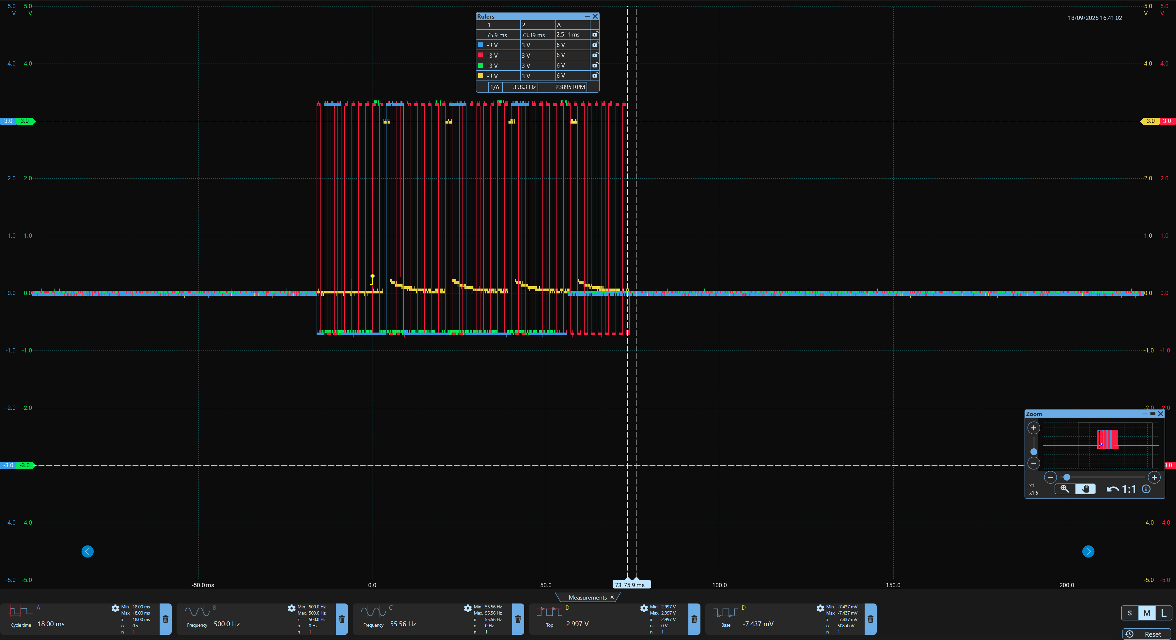
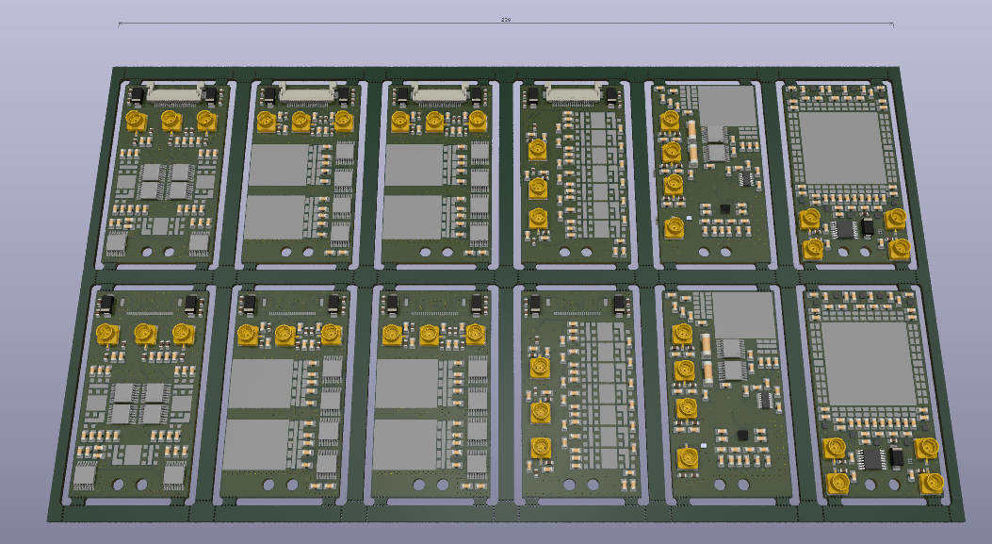
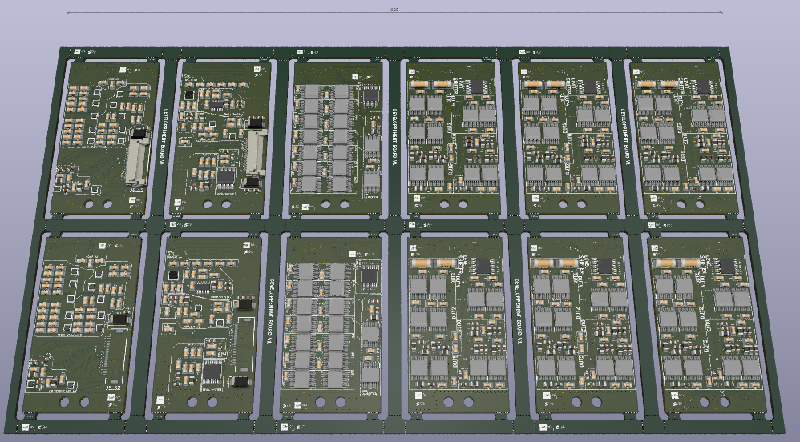
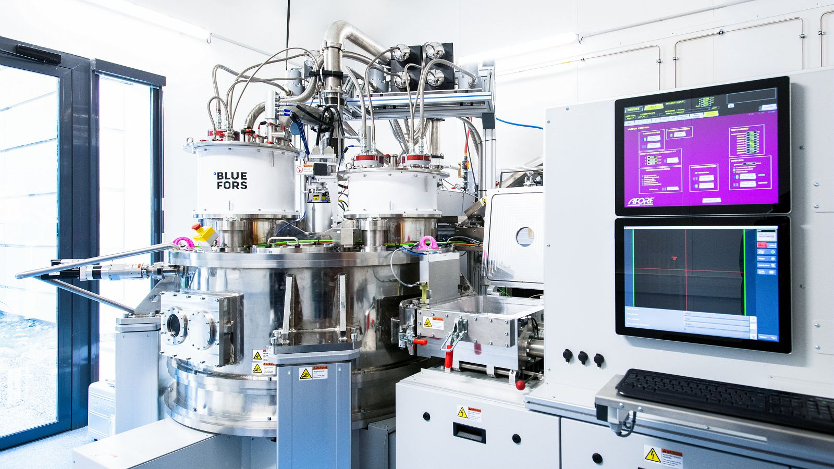
Lab Experience @CEAxISCT
Correct behavior at 4K in Dipstick :D
Circuit Designed @
Final Project: Multiplexing and Amplification board (50 I/Os) for Measure CryoProber to enhance Qubits/Quantum Dots Measurement.
Technical Constraints:
Strict thermal budget management (4 Kelvin stage).
Low-noise Cryogenic I/V converter design.
Signal integrity within a dilution refrigerator

Slide 5
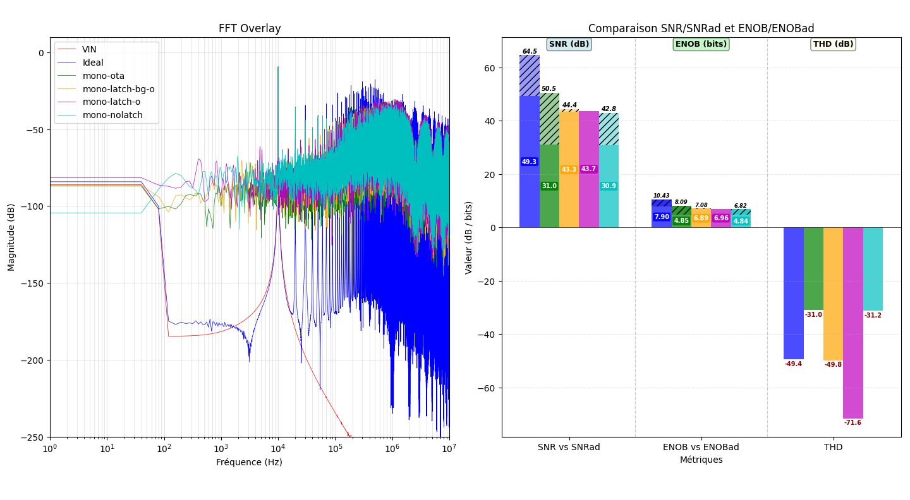
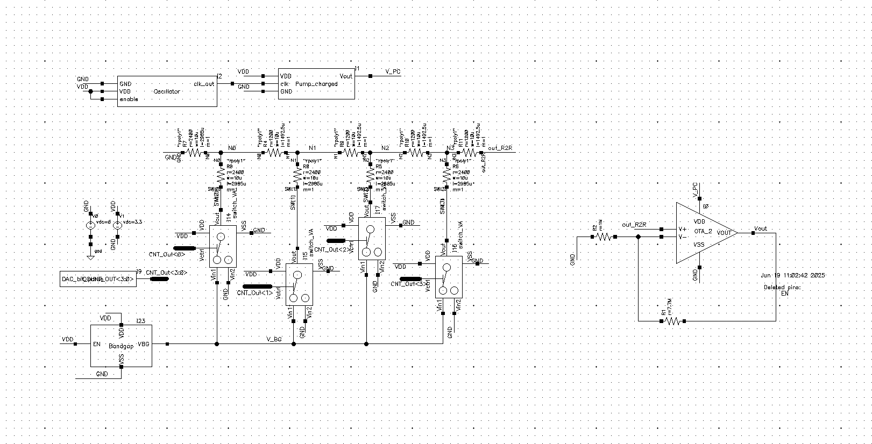
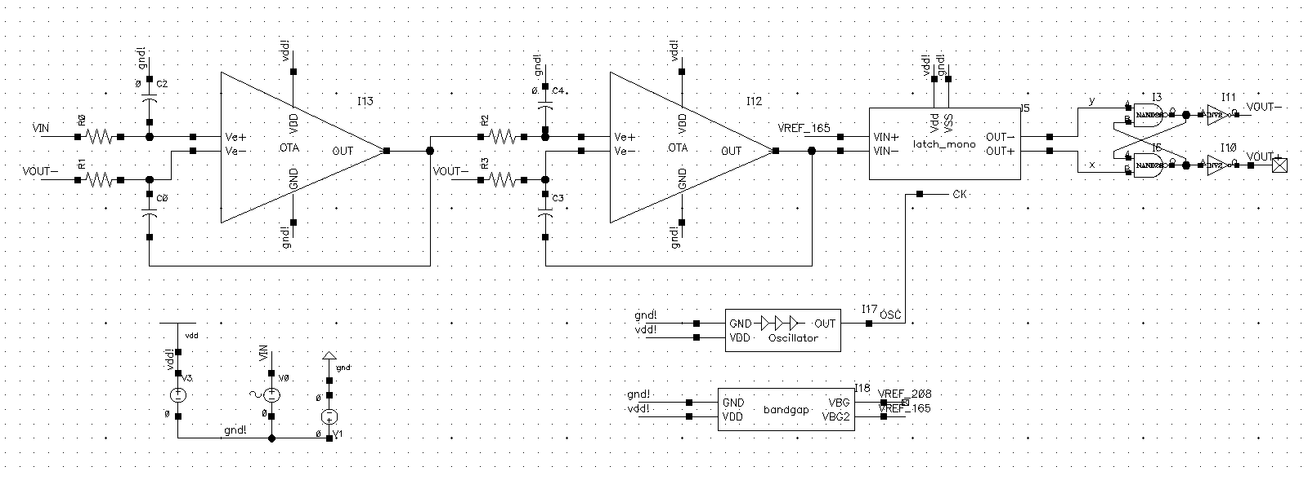
CMOS Designs experiences
ΣΔ ADC – Final Year project in grps of 4
Designed multiple types of CMOS structures ranging from basic current mirrors, Miller OTAs, and charge pumps to more complex structures like R2R DAC and ΣΔ ADC. (on Cadence)
Idéale
Full
OTA
OTA – BG
SA
R2R DAC
2nd year project
Grps of 3

Slide 6
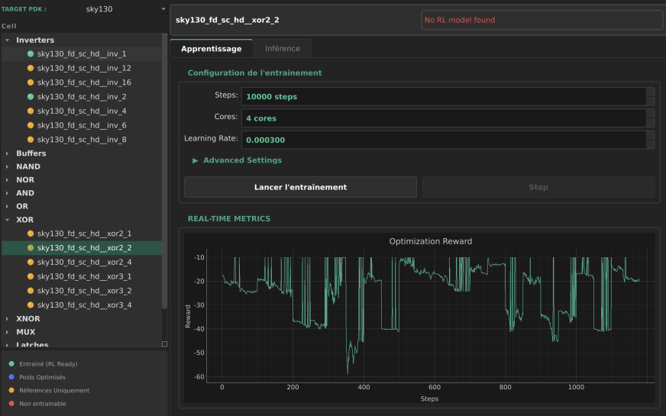
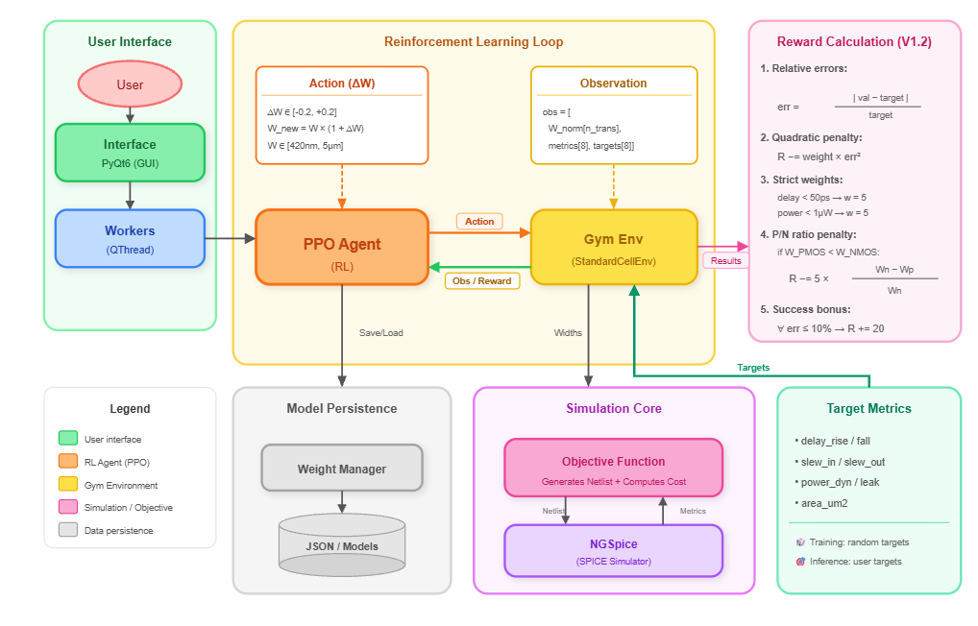
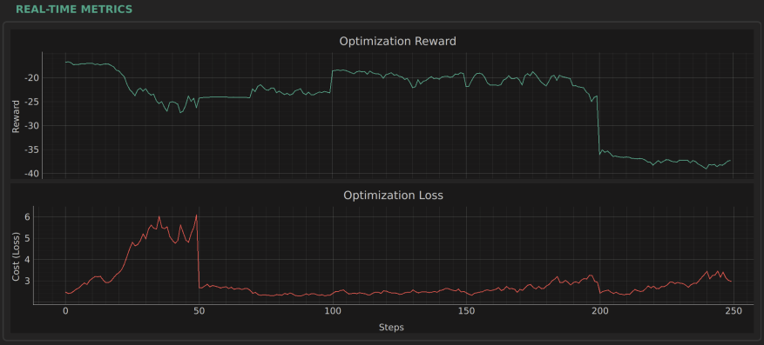
EDA & IA on sky130 pdk

Slide 7
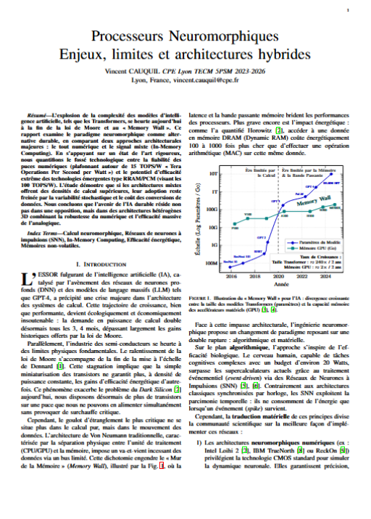
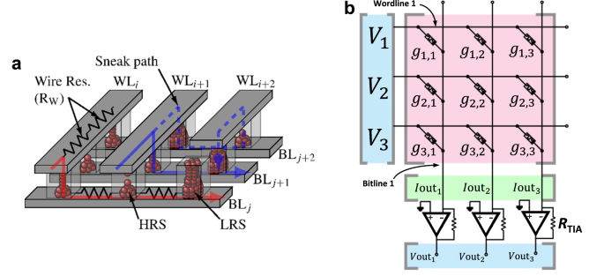
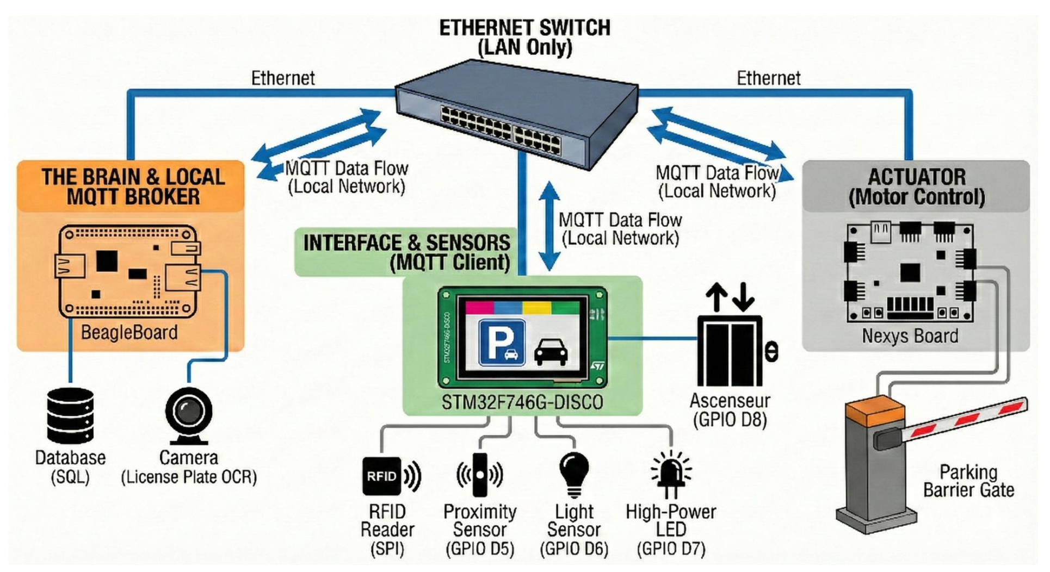
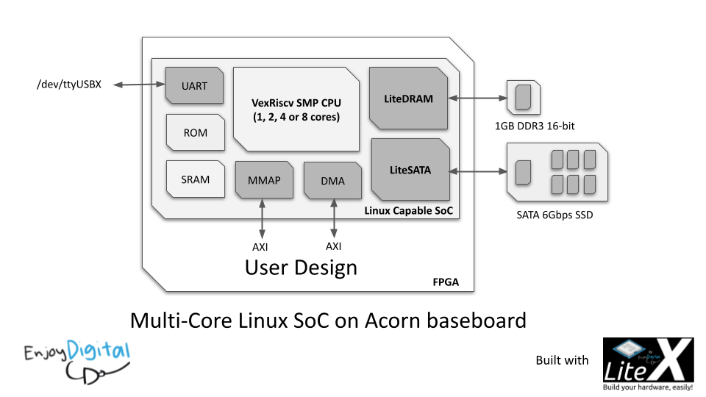
Interest Computing Architecture
System Architecture & SoC Design
Academic Exercise
Writing (in French..) a Scientific review in an IEEE Format
Decided to write on Neuromorphic Processors
Beyond physics, I have a strong interest in how computing systems are architected.
Smart Parking Project: Designed a full autonomous system.
RISC-V Implementation: Deployed a VexRiscv core on FPGA using LiteX.
Full Stack: From AXI bus interconnects to Embedded Linux drivers.

Slide 8
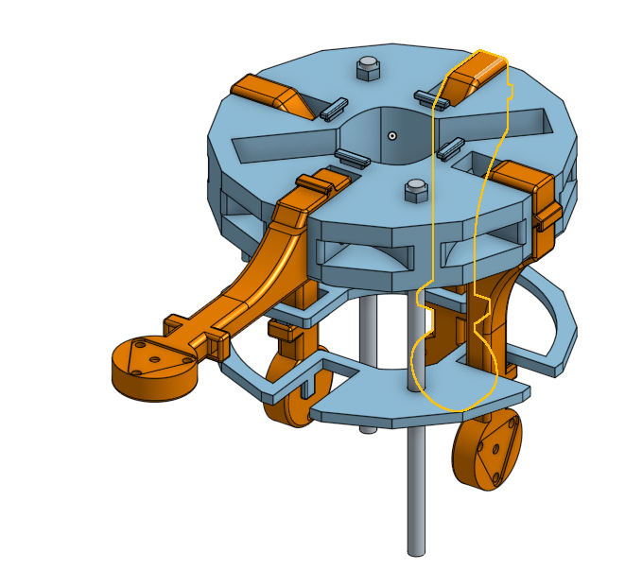
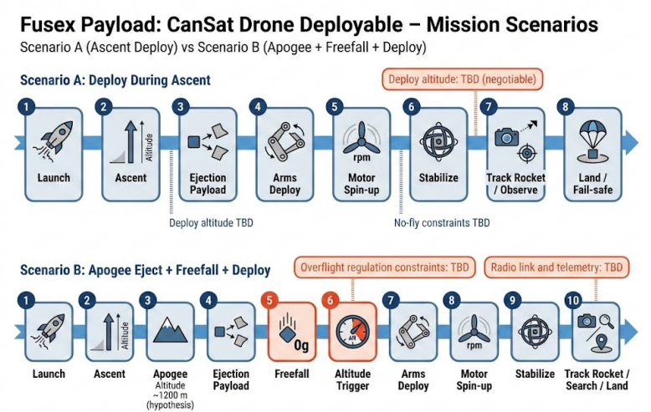
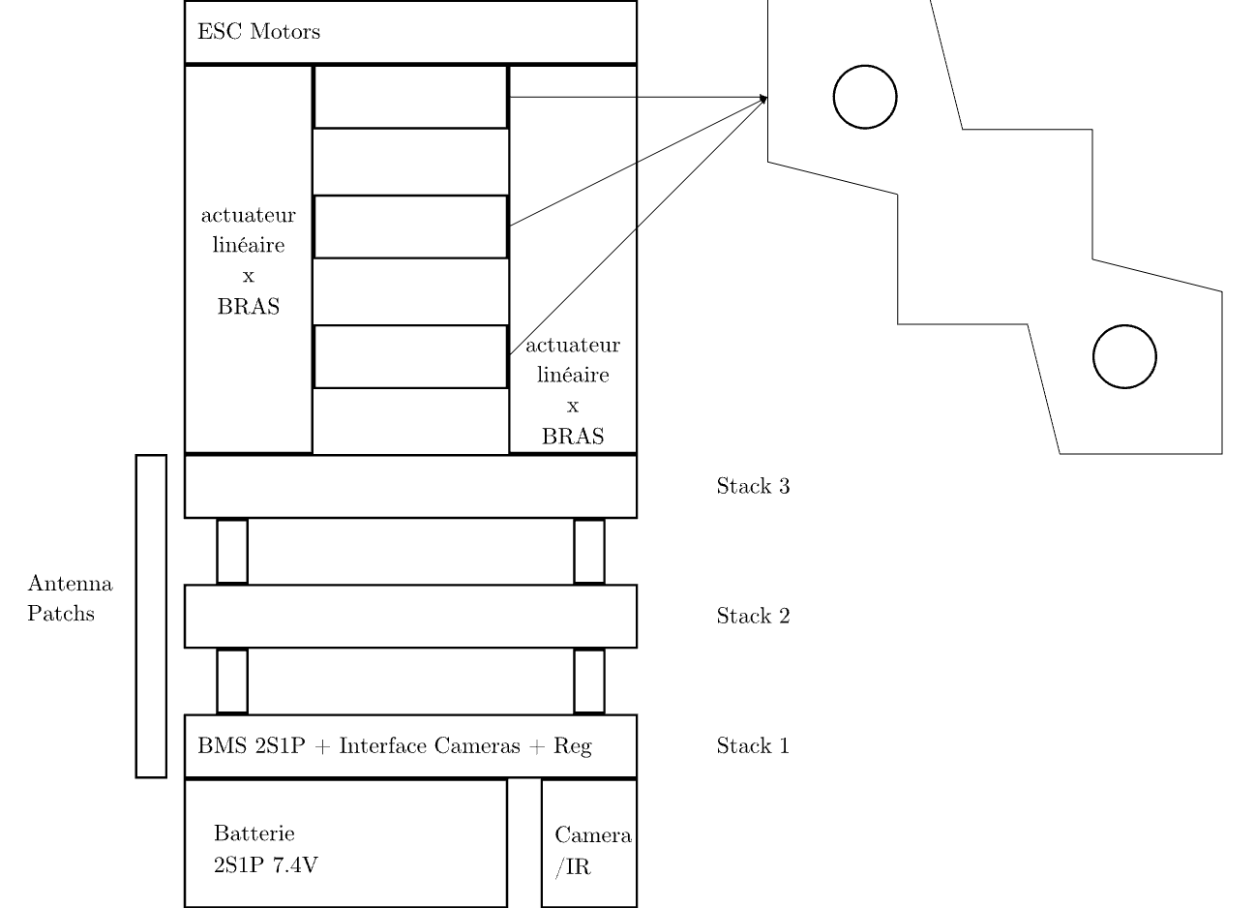

Side projects
Working on a CANSAT, place on a CPE Lyon Rocket project for 4 Years Students, Placed as a client for the rocket, designing the rocket experiment (4 peoples)
In charge of EE & Mechanical Designs
33cl Coke Can restriction
Sponsored by

Slide 9









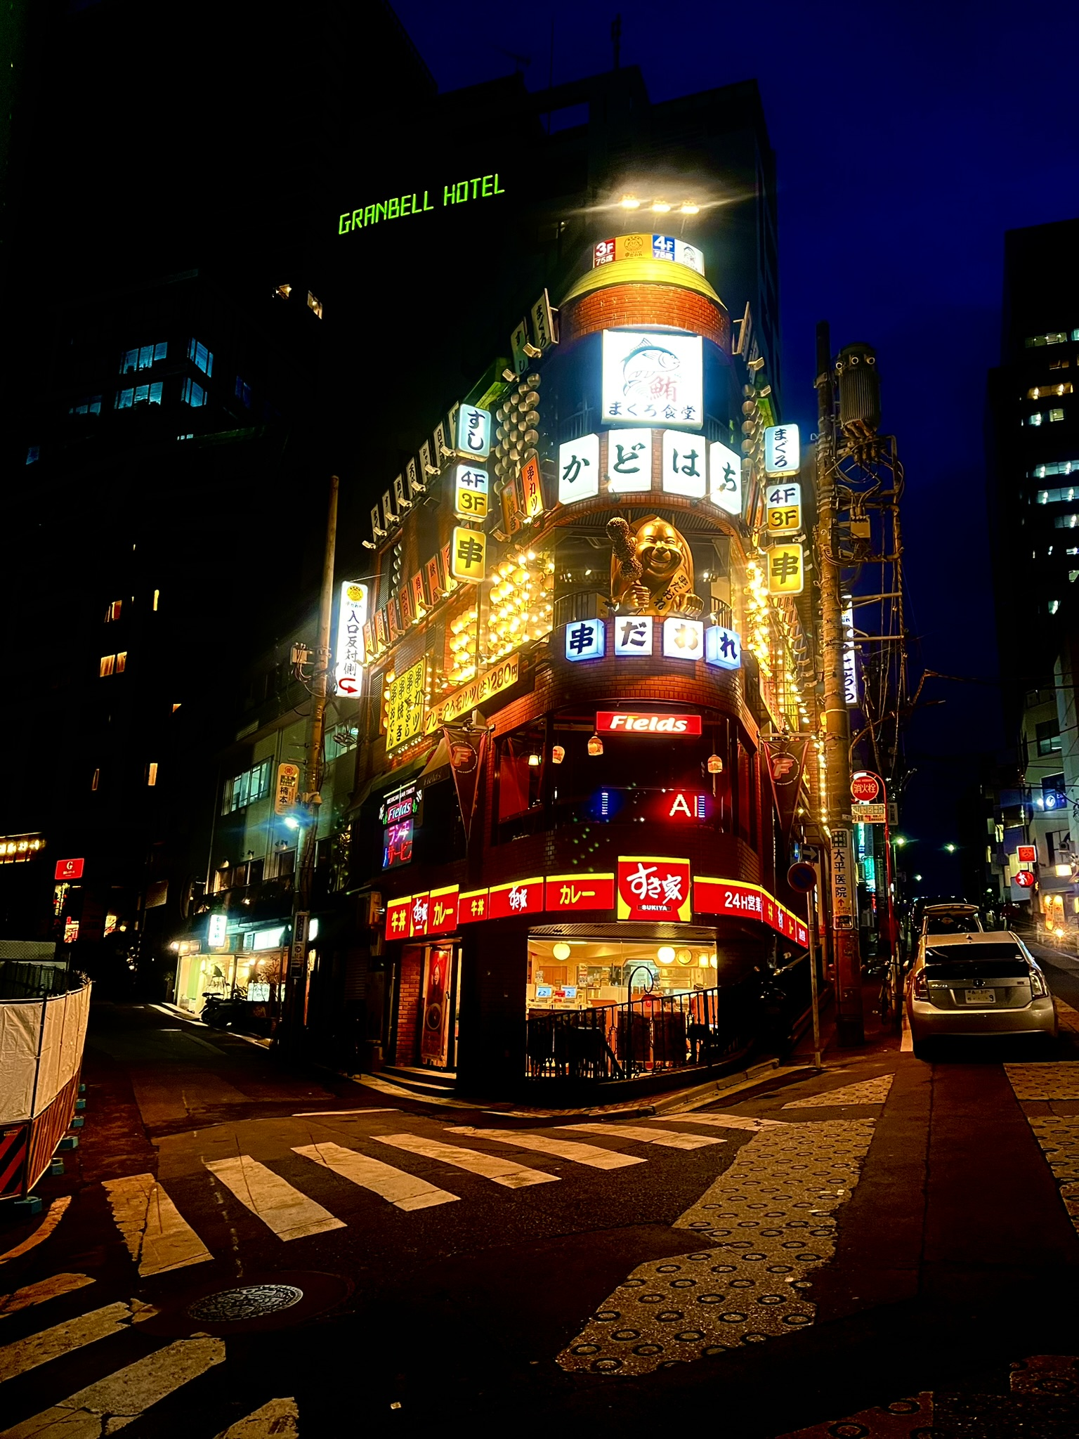
But also a creative person…

Slide 10


Thank you for your attention
My profile combines the rigor of cryogenic physics with the creativity of system architecture.
vincent.cauquil@cpe.fr/cea.fr
/in/vincent-cauquil-6048b3241
/?originalSubdomain=fr

